Slide 1


LUNG CANCER PREDICTION SYSTEM

Slide 2

ROURKELA INSTITUTE OF MANAGEMENT STUDIES
GUIDED BY: PROF. BIBHUDENDU PANDA
PRESENTED BY: PRIYANKA PATEL ANKITA PUROHIT S.MANISH NAIR PRIYANKA PRIYADARSHINI PATI | 05-08-2023

Slide 3
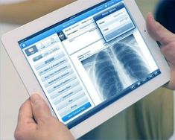

Background
of the Study
project that aims to predict the presence of
lung cancer based on chest X-ray images
Back to Agenda

Slide 4


SCOPE OF THE STUDY | Lung cancer is one of the most common types of cancer, and it is often not detected until it has progressed to an advanced stage, which can limit treatment options and lead to a poorer prognosis
RELEVANCE OF THE STUDY | By using deep learning and image analysis techniques, this system seeks to accurately predict the likelihood of a patient having lung cancer based on their medical imaging data, allowing for earlier detection and more effective treatment options.
Problem Statement
The problem that the Lung Cancer Prediction System using EfficientNet aims to address is the early detection and prediction of lung cancer

Slide 5

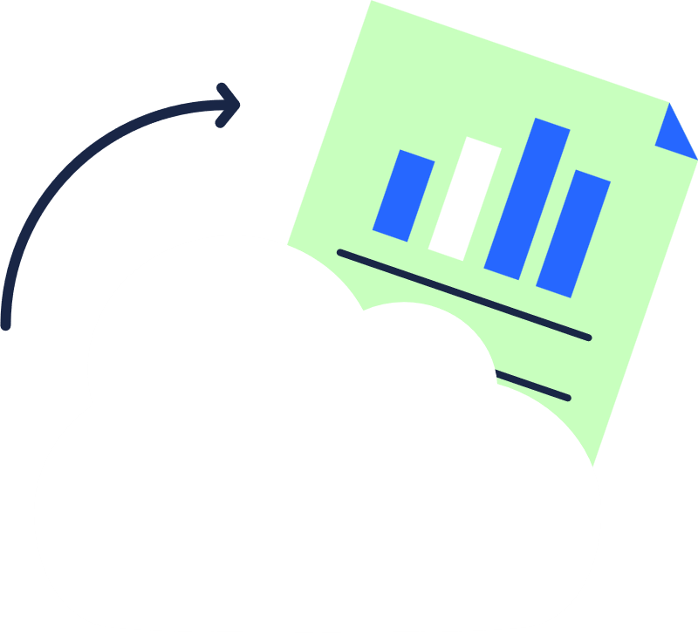

The proposed system of Lung Cancer Prediction System using EfficientNet is a deep learning-based predictive model that utilizes medical imaging data to accurately predict the likelihood of a patient having lung cancer
OVERVIEW | PROPONENTS
It is built using Python Django web framework and utilizes an SQLite database. The system has three main modules - user, admin, and doctor. | The system includes a user interface, allowing users to easily input their medical imaging data and receive a prediction. Additionally, the system includes modules for doctors and administrators, allowing them to manage patient data and view predictions made by the model.

Slide 6


USER MODULES
Signup:
View Doctors:
Based on the user's area/city, the system recommends doctors who specialize in treating lung cancer. This is done after the prediction, in case the system detects lung cancer in the user's chest X-ray.
A user can create a new account by providing
basic details like name, email, and password.
Login:
Edit Profile:
Users can update their profile information like name, email, and contact details.
The users can log in to their account using
the registered email and password.
Prediction:
Change Password:
Users can change their login password for security purposes.
The users can upload their chest X-ray image and get the prediction result if the X-ray shows any indication of lung cancer or not..
View Prediction History:
Logout: Users can log out of the system once they have finished their session.
The users can view their past prediction results in their
profile.

Slide 7




DOCTOR MODULES
Login:
Allows the doctor to log in to their account using their registered credentials.
Profile Management:
Allows the doctor to manage their account details, including personal information, contact details, and login credentials.
Dashboard:
Provides an overview of the doctor's account, including the total number of patients they have treated, the number of patients they have diagnosed with cancer, and the number of patients they have referred to a specialist.
Logout:
Enables the doctor to log out of their account and end their session.
Patient History:
Allows the doctor to view the complete medical history of each patient they have treated. This includes previous diagnoses, lab results, and radiology reports.

Slide 8


ADMIN MODULES
Login:
The admin will have a unique username and password to access the admin panel.
View Registered Doctors:
The admin can view the list of registered doctors along with their details.
Dashboard:
This module will allow the admin to view the total number of users registered, total predictions made, and other related statistics.
Change Password: The admin can change their password using this module.
View Prediction Results
: The admin can view the predictions made by the users along with their details and prediction results.
Logout: The admin can log out of the admin panel using this module.
View Registered Users:
The admin can view the list of registered users along with their details.

Slide 9
Frontend(Language used)
BOOTSTRAP
HTML
CSS
(HYPERTEXT MARKUP LANGUAGE)
(CASCADING STYLE SHEET)
(FRAMEWORK OF CSS AND JS)

Slide 10


BACKEND
PYTHON DJANGO
SQLITE (DATABASE)
Back to Agenda

Slide 11
SOFTWARE USED
PYCHARM IDE
NOTEPAD++ & TEXT EDITOR
CHROME
PYTHON INTERPRETER
(INTEGRATED
DEVELOPMENT ENVIRONMENT)
Back to Agenda

Slide 12
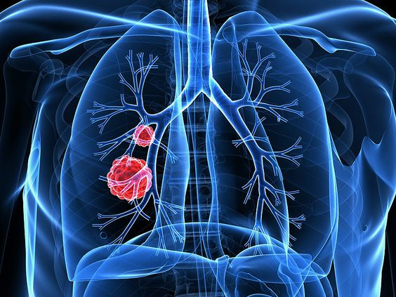
PROJECT SCOPE
The scope of Lung Cancer Prediction System using EfficientNet is significant as it can be used by healthcare professionals, researchers, and organizations in the field of cancer diagnosis and treatment.

Slide 13
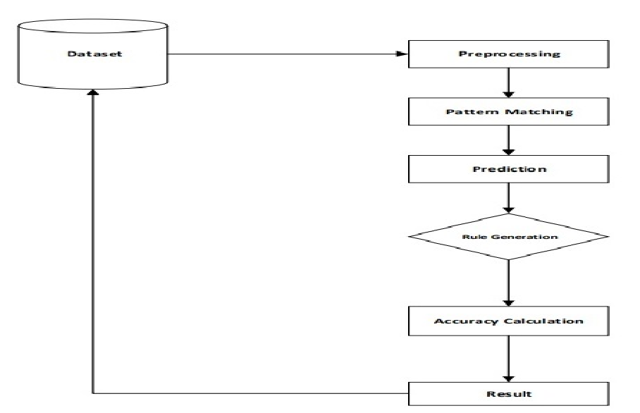
FLOW CHART

Slide 14
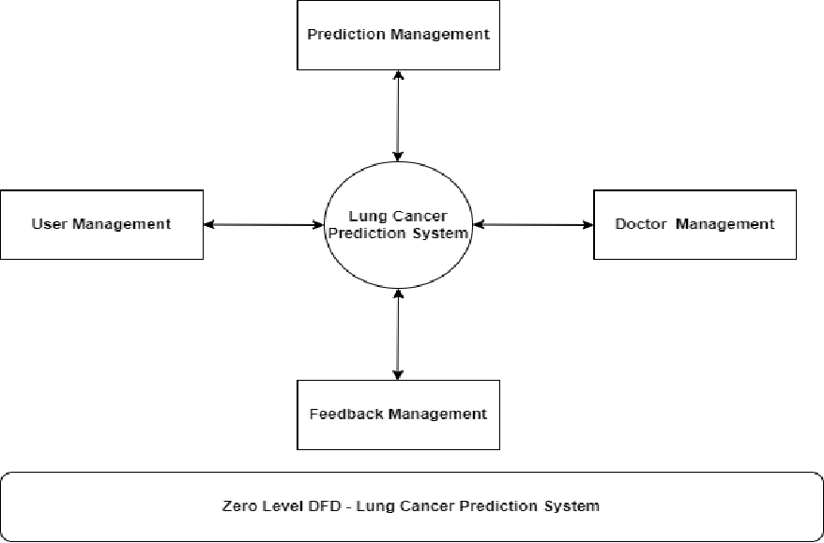
DFD(ZERO LEVEL)
Back to Agenda

Slide 15
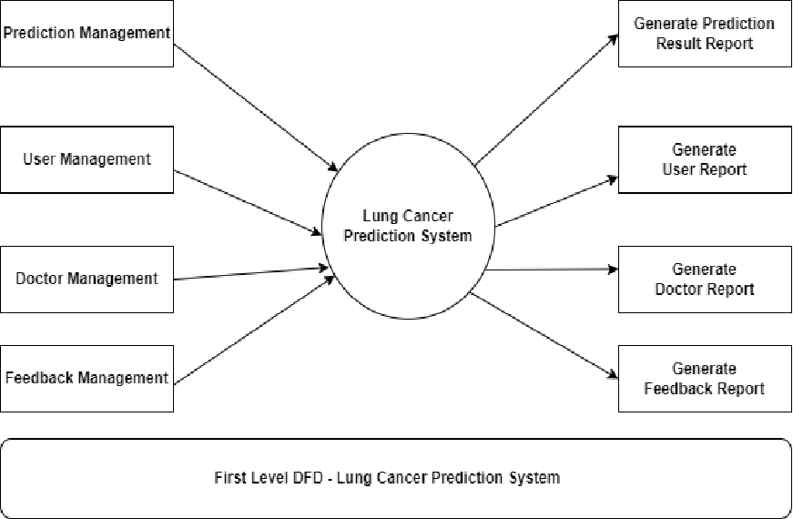
DFD(FIRST LEVEL)

Slide 16
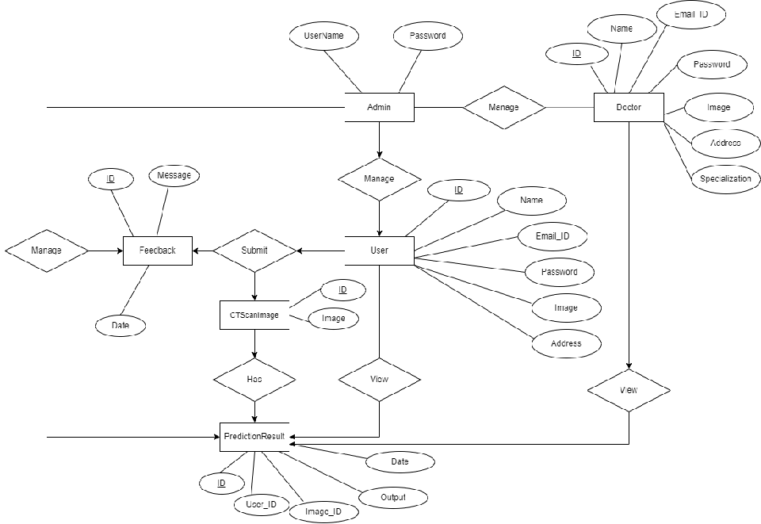
ER DIAGRAM
Back to Agenda

Slide 17
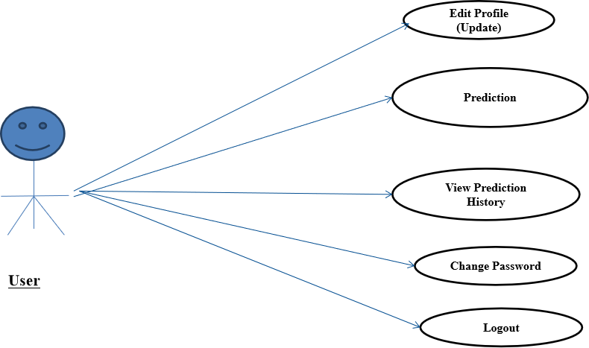
USE CASE DIAGRAM USER

Slide 18
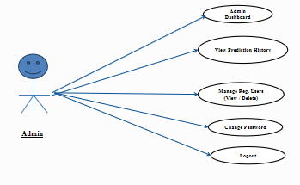
USE CASE DIAGRAM ADMIN

Slide 19
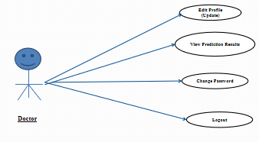
USE CASE DIAGRAM DOCTOR

Slide 20
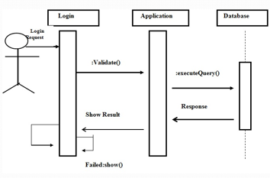
SEQUENCE DIAGRAM

Slide 21

Algorithm Used:-
EfficientNet is a highly efficient deep learning architecture designed for computer vision tasks, including medical image analysis. It optimizes both accuracy and computational efficiency by scaling the model's depth, width, and resolution. In the context of a lung cancer prediction system, EfficientNet can analyze medical images such as chest X-rays or CT scans to accurately predict cancerous or non-cancerous conditions. Its efficiency and effectiveness contribute to improved diagnostic accuracy and potentially earlier detection of lung cancer.

Slide 22
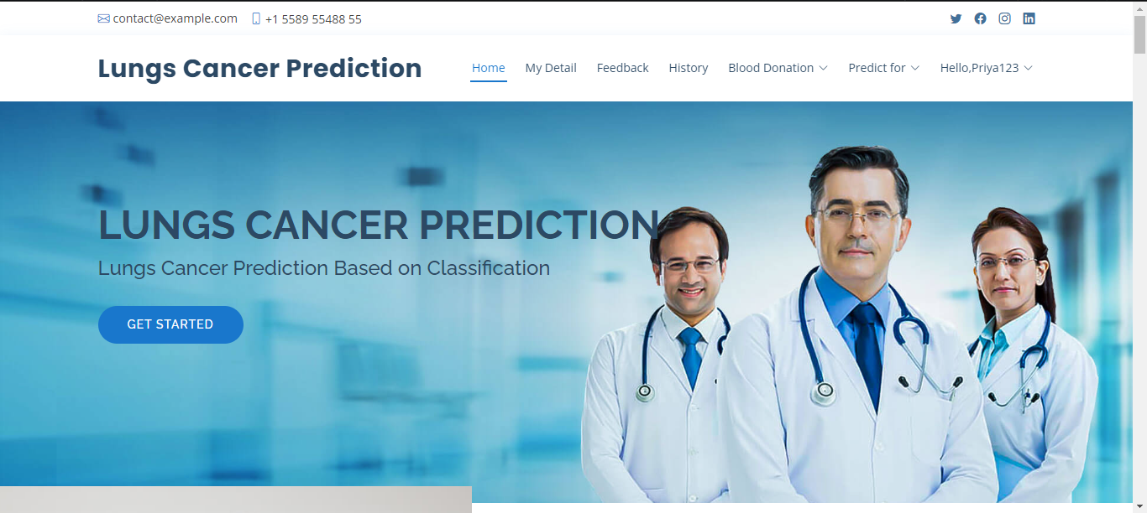

Slide 23
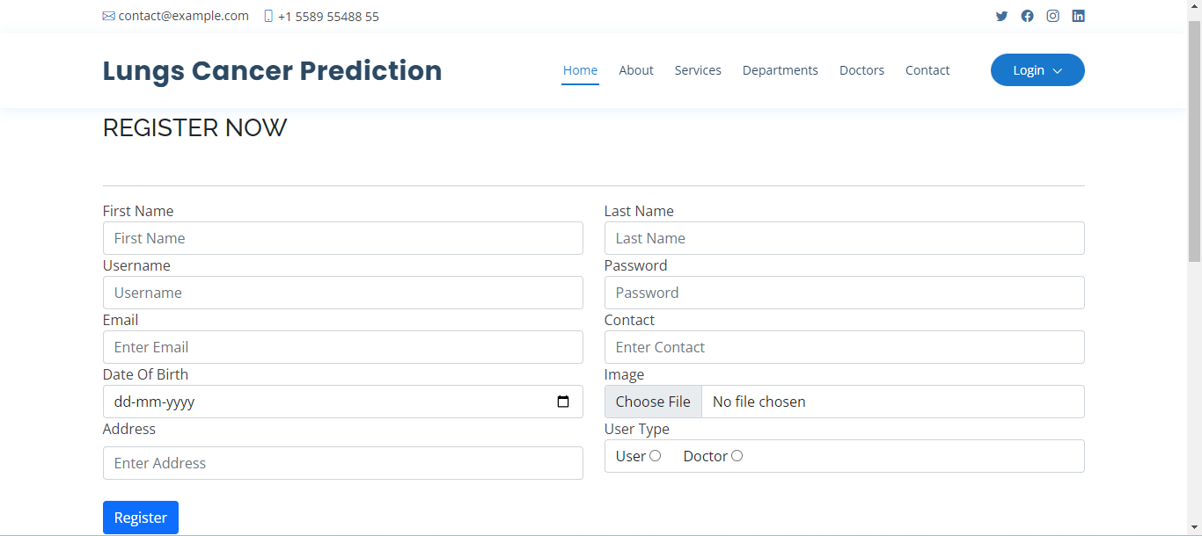

Slide 24
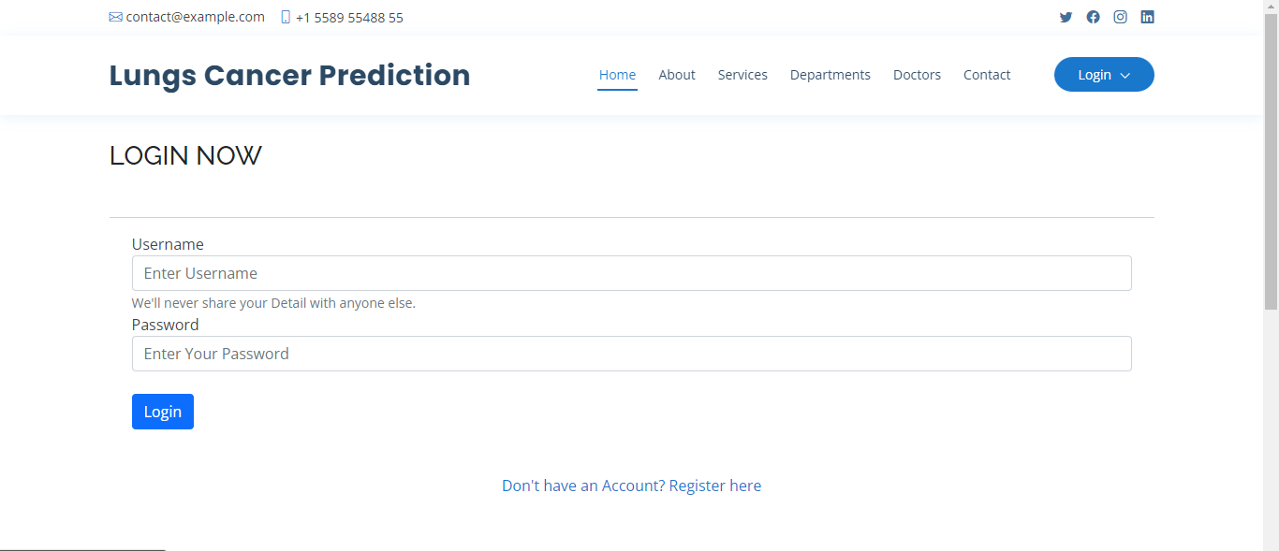

Slide 25
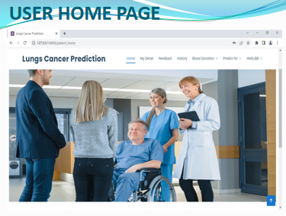

Slide 26
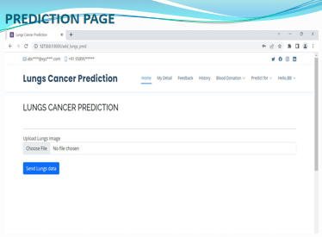

Slide 27
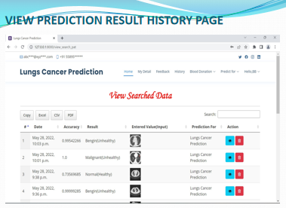

Slide 28
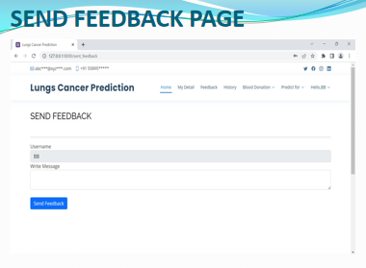

Slide 29
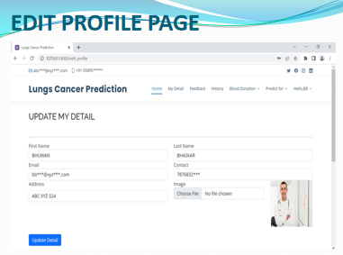

Slide 30
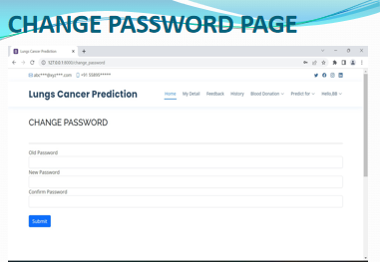

Slide 31
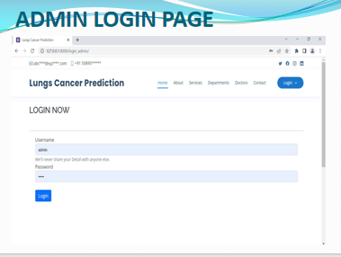

Slide 32
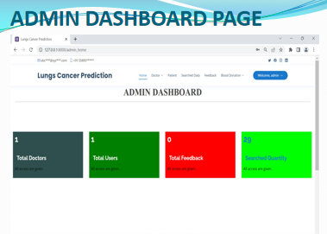

Slide 33
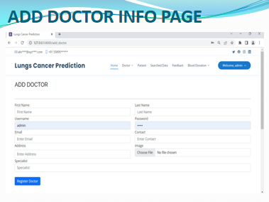

Slide 34
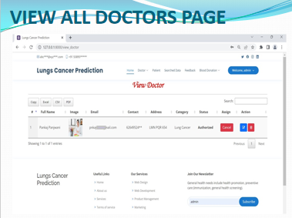

Slide 35
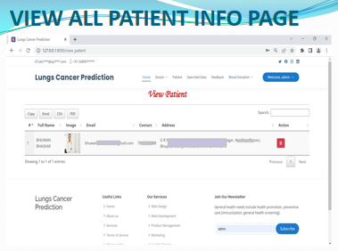

Slide 36
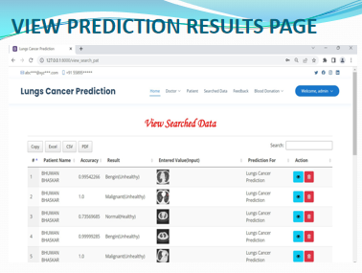

Slide 37
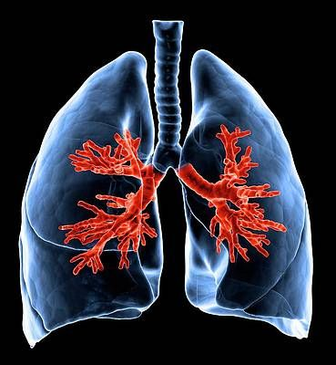
FUTURE SCOPE
promising. Potential directions for future development include improving model accuracy, extending the system for other types of cancer, developing a mobile application for increased accessibility, integrating Electronic Health Records (EHR), enhancing the user interface, collaborating with medical institutes for better data access, and developing a clinical decision support system.

Slide 38

CONCLUSION
Lung Cancer Prediction System using EfficientNet is an innovative and effective solution to predict lung cancer at an early stage.
By implementing deep learning and machine learning techniques, this system can accurately detect and classify lung nodules from CT scan images.
It can assist doctors and patients in making informed decisions regarding further diagnosis and treatment.
The system is highly scalable, efficient, and cost-effective, making it accessible to a large population.
Although there are some limitations, such as the need for high-quality CT scans and a trained model, the benefits of early detection and prevention of lung cancer outweigh them. Overall, the Lung Cancer Prediction System using EfficientNet has the potential to improve healthcare outcomes and save lives.

Slide 39
BIBLIOGRAPHY
FOR PYTHON INSTALLATION
https://www.python.org
FOR HTML , CSS AND PYTHON BASICS
www.w3schools.com
www.javatpoint.com
https://www.geeksforgeeks.org/python-django/
https://panjwanitutorials.com/

Slide 40
REFERENCE BOOKS
"Hands-On Machine Learning with Scikit-Learn and TensorFlow" by Aurélien Géron.
"Python Machine Learning" by Sebastian Raschka and Vahid Mirjalili.
"Pattern Recognition and Machine Learning" by Christopher M. Bishop.
"Machine Learning: A Probabilistic Perspective" by Kevin P. Murphy.
"Healthcare Analytics: From Data to Knowledge to Healthcare Improvement" by Hui Yang.
"Machine Learning in Medicine: A Complete Overview" by Ton J. Cleophas and Aeilko H. Zwinderman.
"Data Science for Healthcare: Methodologies and Applications" by Radhakrishnan Nagarajan, Foyzur Rahman, and Arunima Srivastava.
Two scoops of Django for 1.11 by Daniel Greenfeld’s and Audrey Greenfield.
Lightweight Django by Elman and Mark Lavin.

Slide 41








Our team
PRIYANKA PATEL
ANKITA PUROHIT
PRIYANKA PRIYADARSHINI PATI
S.MANISH NAIR

Slide 42

THANK YOU
For watching this presentation

